Slide 1
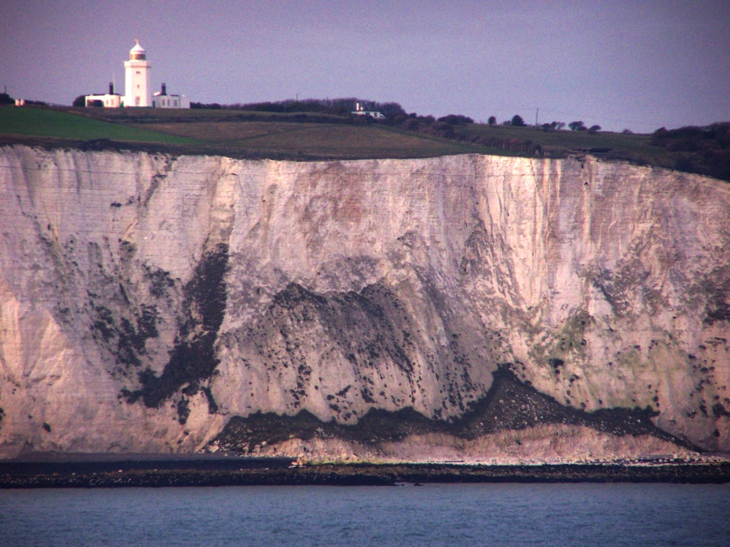
Poetry Analysis through ratiocination
But Can’t Poems Mean Anything ?

Slide 2
Dover Beach
BY MATTHEW ARNOLD
The sea is calm tonight.
The tide is full, the moon lies fair
Upon the straits; on the French coast the light
Gleams and is gone; the cliffs of England stand,
Glimmering and vast, out in the tranquil bay.
Come to the window, sweet is the night-air!
Only, from the long line of spray
Where the sea meets the moon-blanched land,
Listen! you hear the grating roar
Of pebbles which the waves draw back, and fling,
At their return, up the high strand,
Begin, and cease, and then again begin,
With tremulous cadence slow, and bring
The eternal note of sadness in.
Sophocles long ago
Heard it on the Ægean, and it brought
Into his mind the turbid ebb and flow
Of human misery; we
Find also in the sound a thought,
Hearing it by this distant northern sea.
The Sea of Faith
Was once, too, at the full, and round earth’s shore
Lay like the folds of a bright girdle furled.
But now I only hear
Its melancholy, long, withdrawing roar,
Retreating, to the breath
Of the night-wind, down the vast edges drear
And naked shingles of the world.
Ah, love, let us be true
To one another! for the world, which seems
To lie before us like a land of dreams,
So various, so beautiful, so new,
Hath really neither joy, nor love, nor light,
Nor certitude, nor peace, nor help for pain;
And we are here as on a darkling plain
Swept with confused alarms of struggle and flight,
Where ignorant armies clash by night.

Slide 3

Look at a Poem “this way”
POEMS have a theme or message
POEMS elicit an emotional reaction from the audience- could be positive or negative
POEMS have specific and excellent word choice
POEMS can make sense on several different levels, literally and/or symbolically

Slide 4

Look Here!
POEMS have good technique and/or use of form/style
POEMS are original in some way(s)
POEMS serve as inspiration for others
POEMS include good imagery (physically, mentally, or emotionally)

Slide 5
Method Makes Meaning
Knowing about the poetic techniques used in a poem is pretty useless if you don’t think about how they go with/add to the meaning of the poem
Think about the poem’s content and figure out what the poem is about.

Slide 6

Technical Side
Once you’ve thought about the meaning of the poem, you need to look at the “technical” side – look at terms and form.
Does the poem follow a specific form or use a specific style ( sonnet)?
What do you notice about the poem after looking at it from the technical side that you didn’t notice when you looked at the content?

Slide 7
10 Easy Steps to Figure Out What the Poem Means
Notice the title- Make notes about your initial reactions at the top of the poem
Return to the later to reevaluate its significance

Slide 8
Find the Independent Clauses
Read them individually
They might not end at the ends of lines
Notice any that are questions
For each independent clause, underline the subject once, predicate twice, and complement three times
Clauses might not come in “natural” order, so turn them around

Slide 9
Locate the Prepositions
Put a check mark over them and bracket the prepositional phrases
Into, before, after, around, near, on ….

Slide 10
Detect the “Turning” words (fanboys)
But
Yet
So
However
Mark the shifts if no words are used turns.
Put an asterisk besides these

Slide 11
Look Up Significant Words
Maintain awareness of both denotative and connotative meanings
Underline these words, and write synonyms above the words in the poem
Consider how diction affects TONE

Slide 12
Note the Structure
Meter
Rhyme scheme
Breaks between lines
Length of stanzas
Think about how these aspects help to organize the poem’s ideas and to identify “turns”

Slide 13
Look for Words Used Figuratively
First, Similes
Then, metaphors
Circle them and draw an arrow to the comparison.
Next, consider possible symbols

Slide 14
Explore for Allusions
Look them up if you need to
Take notes about these references in the margin.

Slide 15
Think About Point of View
Consider the speaker not in terms of a name but in terms of character traits.
Is this person speaking to someone or something in particular?
Check the title again
Make notes in the margin

Slide 16
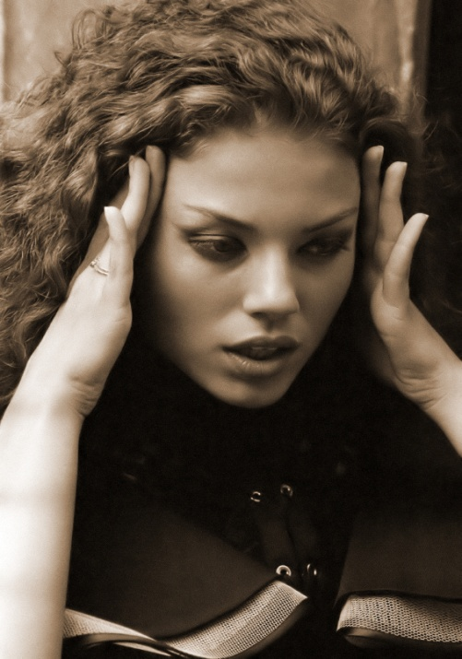
Examine the Tone
What is the attitude that the speaker and author express?
Place + signs over the positive tone words
Place - signs over the negative words
Note the place where a shift occurs

Slide 17
Statements about Figurative Language
Complete the following template:
  The poem “______________”
  by __________
  conveys* ______________,
      (abstract idea or concept)
  and reveals* _________________.
      (message about the abstract idea)
*or choose another active verb you deem appropriate

